Slide 1
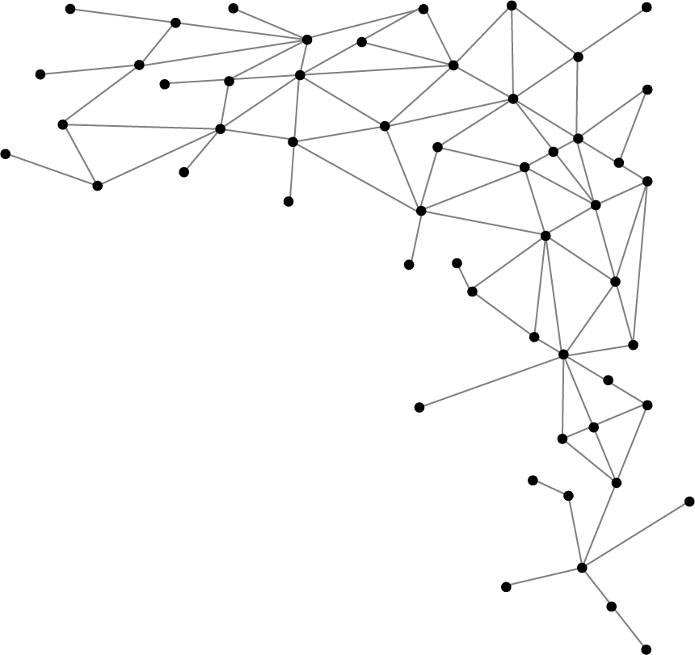




Machine Learning
I am Saif Hassan
Lecturer (CS@SIBAU)
@saifhassandr
@saifhassandr

Slide 2
Agenda
From Rules to Trees
Entropy
Information Gain
Building Trees
C4.5 (Improvement to ID3)
Pros & Cons of DT

Slide 3
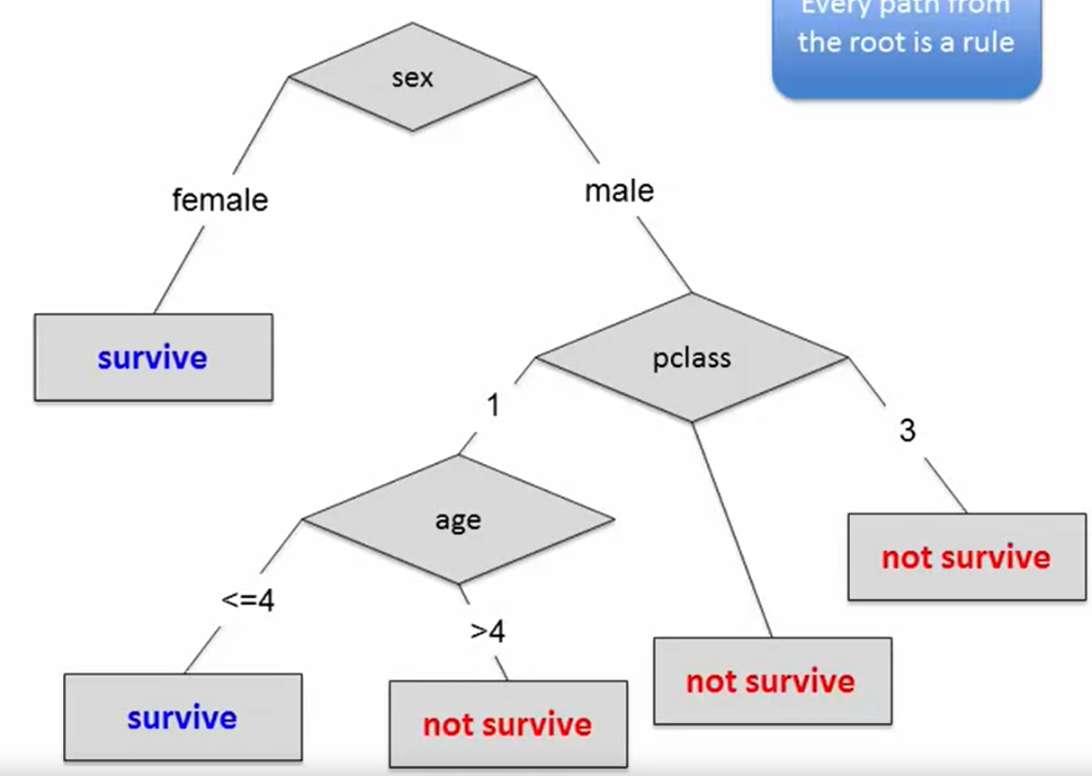
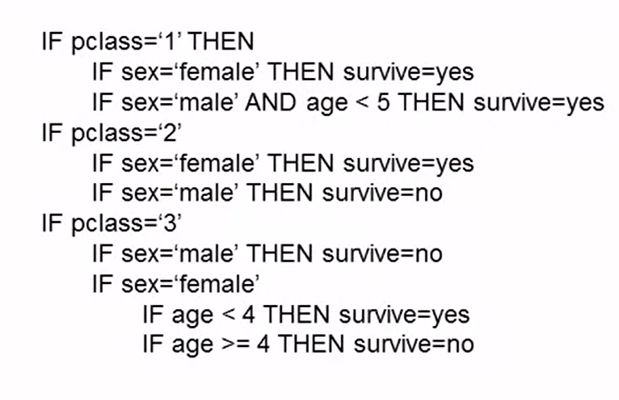
From Rules to Trees

Slide 4
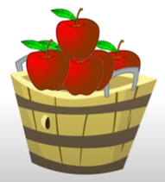
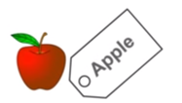
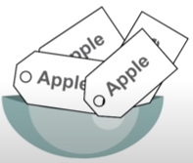
Impurity
Impurity = 0

Slide 5

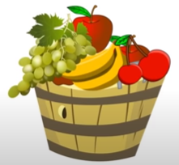
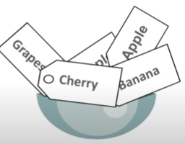
Impurity
Impurity ≠ 0

Slide 6
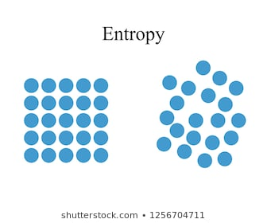
What is Entropy?
Randomness in data
Metric for measuring the impurity
Low entropy
High entropy

Slide 7
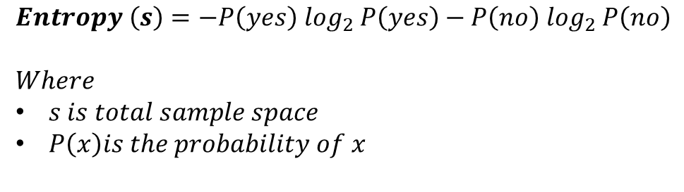
Entropy (Cont.)
$$Entropy \left(s\right)=−P\left(yes\right)\log_{2} P\left(yes\right)−P\left(no\right)\log_{2} P\left(no\right)$$
$$Where$$
$s is total sample space$
$P\left(x\right)is the probability of x$
If # of yes = # of no i.e. P(s) = 0.5
Entropy (s) = 1
If all yes or all no i.e. P(s) = 1 or 0
Entropy (s) = 0

Slide 8
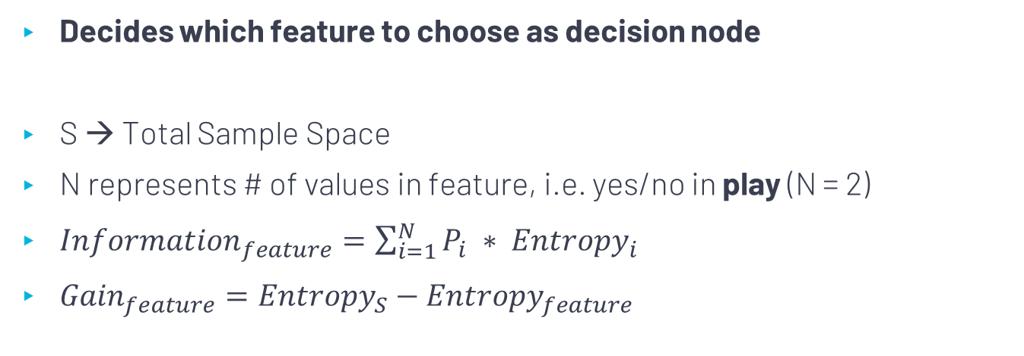
Information Gain
Decides which feature to choose as decision node
S → Total Sample Space
N represents # of values in feature, i.e. yes/no in play (N = 2)
${Information}_{feature}=\sum_{i=1}^{N}{P_{i} ∗ {Entropy}_{i}}$
${Gain}_{feature}={Entropy}_{S}−{Entropy}_{feature}$
Notes:
https://blog.quantinsti.com/gini-index/

Slide 9
Build Decision Tree
1
Using information gain to build trees

Slide 10

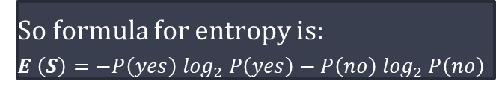
Computer Entropy of Dataset
S. No# | Outlook | Temp | Humidity | Windy | Play
1 | overcast | hot | high | FALSE | yes
2 | overcast | cool | normal | TRUE | yes
3 | overcast | mild | high | TRUE | yes
4 | overcast | hot | normal | FALSE | yes
5 | rainy | mild | high | FALSE | yes
6 | rainy | cool | normal | FALSE | yes
7 | rainy | cool | normal | TRUE | no
8 | rainy | mild | normal | FALSE | yes
9 | rainy | mild | high | TRUE | no
10 | sunny | hot | high | FALSE | no
11 | sunny | hot | high | TRUE | no
12 | sunny | mild | high | FALSE | no
13 | sunny | cool | normal | FALSE | yes
14 | sunny | mild | normal | TRUE | yes
Dataset contains:
Yes → 9 instances
No → 5 instances
So formula for entropy is:
$$E \left(S\right)=−P\left(yes\right)\log_{2} P\left(yes\right)−P\left(no\right)\log_{2} P\left(no\right)$$
$$E \left(S\right)=−\frac{9}{14}\log_{2}\frac{9}{14}−\frac{5}{14}\log_{2}\frac{5}{14}$$
$$E \left(S\right)=0.41+0.53=0.94$$

Slide 11
Which feature to choose as root
S. No# | Outlook | Temp | Humidity | Windy | Play
1 | overcast | hot | high | FALSE | yes
2 | overcast | cool | normal | TRUE | yes
3 | overcast | mild | high | TRUE | yes
4 | overcast | hot | normal | FALSE | yes
5 | rainy | mild | high | FALSE | yes
6 | rainy | cool | normal | FALSE | yes
7 | rainy | cool | normal | TRUE | no
8 | rainy | mild | normal | FALSE | yes
9 | rainy | mild | high | TRUE | no
10 | sunny | hot | high | FALSE | no
11 | sunny | hot | high | TRUE | no
12 | sunny | mild | high | FALSE | no
13 | sunny | cool | normal | FALSE | yes
14 | sunny | mild | normal | TRUE | yes
Humidity
Windy
Outlook
Temp

Slide 12
Which feature to choose as root
S. No# | Outlook | Temp | Humidity | Windy | Play
1 | overcast | hot | high | FALSE | yes
2 | overcast | cool | normal | TRUE | yes
3 | overcast | mild | high | TRUE | yes
4 | overcast | hot | normal | FALSE | yes
5 | rainy | mild | high | FALSE | yes
6 | rainy | cool | normal | FALSE | yes
7 | rainy | cool | normal | TRUE | no
8 | rainy | mild | normal | FALSE | yes
9 | rainy | mild | high | TRUE | no
10 | sunny | hot | high | FALSE | no
11 | sunny | hot | high | TRUE | no
12 | sunny | mild | high | FALSE | no
13 | sunny | cool | normal | FALSE | yes
14 | sunny | mild | normal | TRUE | yes
Outlook
Overcast
Yes
Yes
Yes
Yes
Rainy
Yes
Yes
Yes
No
No
Sunny
Yes
Yes
No
No
No

Slide 13
Computing entropy of each value in Outlook
S. No# | Outlook | Temp | Humidity | Windy | Play
1 | overcast | hot | high | FALSE | yes
2 | overcast | cool | normal | TRUE | yes
3 | overcast | mild | high | TRUE | yes
4 | overcast | hot | normal | FALSE | yes
5 | rainy | mild | high | FALSE | yes
6 | rainy | cool | normal | FALSE | yes
7 | rainy | cool | normal | TRUE | no
8 | rainy | mild | normal | FALSE | yes
9 | rainy | mild | high | TRUE | no
10 | sunny | hot | high | FALSE | no
11 | sunny | hot | high | TRUE | no
12 | sunny | mild | high | FALSE | no
13 | sunny | cool | normal | FALSE | yes
14 | sunny | mild | normal | TRUE | yes
$$E (S)=−P\left(yes\right)\log_{2} P\left(yes\right)−P\left(no\right)\log_{2} P\left(no\right)$$
$E \left({Outlook}_{overcast}\right)=−1\log_{2} 1−0 \log_{2} 0$ = 0
$E \left({Outlook}_{rainy}\right)=−\frac{3}{5}\log_{2} \frac{3}{5}−\frac{2}{5} \log_{2}\frac{2}{5}$ = 0.971
$E \left({Outlook}_{sunny}\right)=−\frac{2}{5}\log_{2} \frac{2}{5}−\frac{3}{5} \log_{2}\frac{3}{5}$ = 0.971

Slide 14


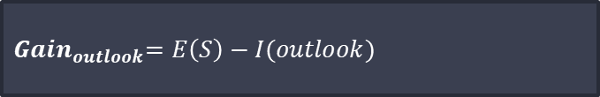
Computing Information Gain for Outlook
S. No# | Outlook | Temp | Humidity | Windy | Play
1 | overcast | hot | high | FALSE | yes
2 | overcast | cool | normal | TRUE | yes
3 | overcast | mild | high | TRUE | yes
4 | overcast | hot | normal | FALSE | yes
5 | rainy | mild | high | FALSE | yes
6 | rainy | cool | normal | FALSE | yes
7 | rainy | cool | normal | TRUE | no
8 | rainy | mild | normal | FALSE | yes
9 | rainy | mild | high | TRUE | no
10 | sunny | hot | high | FALSE | no
11 | sunny | hot | high | TRUE | no
12 | sunny | mild | high | FALSE | no
13 | sunny | cool | normal | FALSE | yes
14 | sunny | mild | normal | TRUE | yes
$${Information}_{feature}=\sum_{i=1}^{N}{P_{i} ∗ {Entropy}_{i}}$$
$${Info}_{outlook}=\frac{5}{14} ∗0.971+\frac{4}{14}∗0+\frac{5}{14}∗0.971=0.693$$
$${ Gain}_{outlook}=E\left(S\right)−I(outlook)$$
$${Gain}_{outlook}=0.94−0.693=0.247$$

Slide 15
Which feature to choose as root
S. No# | Outlook | Temp | Humidity | Windy | Play
1 | overcast | hot | high | FALSE | yes
2 | overcast | cool | normal | TRUE | yes
3 | overcast | mild | high | TRUE | yes
4 | overcast | hot | normal | FALSE | yes
5 | rainy | mild | high | FALSE | yes
6 | rainy | cool | normal | FALSE | yes
7 | rainy | cool | normal | TRUE | no
8 | rainy | mild | normal | FALSE | yes
9 | rainy | mild | high | TRUE | no
10 | sunny | hot | high | FALSE | no
11 | sunny | hot | high | TRUE | no
12 | sunny | mild | high | FALSE | no
13 | sunny | cool | normal | FALSE | yes
14 | sunny | mild | normal | TRUE | yes
Windy
False
Yes
Yes
Yes
Yes
Yes
Yes
No
No
True
Yes
Yes
Yes
No
No
No

Slide 16

Computing entropy of each value in Windy
S. No# | Outlook | Temp | Humidity | Windy | Play
1 | overcast | hot | high | FALSE | yes
2 | overcast | cool | normal | TRUE | yes
3 | overcast | mild | high | TRUE | yes
4 | overcast | hot | normal | FALSE | yes
5 | rainy | mild | high | FALSE | yes
6 | rainy | cool | normal | FALSE | yes
7 | rainy | cool | normal | TRUE | no
8 | rainy | mild | normal | FALSE | yes
9 | rainy | mild | high | TRUE | no
10 | sunny | hot | high | FALSE | no
11 | sunny | hot | high | TRUE | no
12 | sunny | mild | high | FALSE | no
13 | sunny | cool | normal | FALSE | yes
14 | sunny | mild | normal | TRUE | yes
$$E (S)=−P\left(yes\right)\log_{2} P\left(yes\right)−P\left(no\right)\log_{2} P\left(no\right)$$
$E \left({Windy}_{True}\right)=−\frac{3}{6}\log_{2}\frac{3}{6}−\frac{3}{6} \log_{2}\frac{3}{6}$ = 1
$E \left({Windy}_{False}\right)=−\frac{6}{8}\log_{2} \frac{6}{8}−\frac{2}{8} \log_{2}\frac{2}{8}$ = 0.811

Slide 17

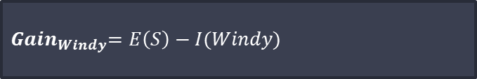
Computing Information Gain for Windy
S. No# | Outlook | Temp | Humidity | Windy | Play
1 | overcast | hot | high | FALSE | yes
2 | overcast | cool | normal | TRUE | yes
3 | overcast | mild | high | TRUE | yes
4 | overcast | hot | normal | FALSE | yes
5 | rainy | mild | high | FALSE | yes
6 | rainy | cool | normal | FALSE | yes
7 | rainy | cool | normal | TRUE | no
8 | rainy | mild | normal | FALSE | yes
9 | rainy | mild | high | TRUE | no
10 | sunny | hot | high | FALSE | no
11 | sunny | hot | high | TRUE | no
12 | sunny | mild | high | FALSE | no
13 | sunny | cool | normal | FALSE | yes
14 | sunny | mild | normal | TRUE | yes
$${Information}_{feature}=\sum_{i=1}^{N}{P_{i} ∗ {Entropy}_{i}}$$
$${Info}_{windy}=\frac{8}{14} ∗0.811+\frac{6}{14}∗1=0.892$$
$${ Gain}_{Windy}=E\left(S\right)−I(Windy)$$
$${Gain}_{windy}=0.94−0.892=0.048$$

Slide 18


Similarly, we computed information gain for temp and humidity
$${Gain}_{temp}=0.029$$
$${Gain}_{humidity}=0.152$$

Slide 19




Which feature to choose as root
Feature with highest Gain will be Root, e.g. Outlook
$${Gain}_{outlook}=0.247$$
$${Gain}_{temp}=0.029$$
$${Gain}_{windy}=0.048$$
$${Gain}_{humidity}=0.152$$

Slide 20
Which feature to choose next
Outlook
overcast
rainy
sunny
Yes
???
???
No need to compute for overcast, as it contains only YES
Compute again in the same way for sunny and rainy

Slide 21
Which feature to choose next
Outlook
sunny
rainy
overcast
Humidity
Windy
Yes
High
Normal
False
True
No
Yes
Yes
No

Slide 22
C4.5 (Improvements to ID3)
Handling discrete as well as continuous attributes
Handling training data with missing attribute values
Missing values are simply not used in entropy and gain
Pruning trees after creation

Slide 23

ref: https://scikit-learn.org/stable/tutorial/machine_learning_map/index.html

Slide 24
Pros and Cons - DT
Pros
Easy to understand and interpret
Can work with numerical and categorical features
Handles irrelevant attributes (Info Gain = 0)
Cons
Overfitting in data
Small change in the data can result in large change in tree structure

Slide 25
Extra Links
https://blog.quantinsti.com/gini-index/

